Slide 1
Retail Price Optimization

Slide 2
Aya Tantawy
Selvana Tadros
Youssef Wael
Mohamed Helmy

Slide 3

Retail Price Optimization: A Comprehensive Approach
Price optimization involves analyzing data to determine the best price points for products. It considers factors such as demand elasticity, competitor pricing, and customer behavior, ensuring that retailers can maximize their revenue and market share.

Slide 4
Introduction
Retail price optimization is a crucial process for businesses aiming to balance profitability, market competitiveness, and customer satisfaction. As a data analyst, your goal is to leverage data-driven insights to optimize pricing strategies, ensuring that products are priced effectively to meet business goals.
In a competitive retail landscape, strategic price optimization is crucial for enhancing profitability and maintaining competitiveness. This presentation will explore various methodologies and tools that can assist retailers in setting optimal prices to achieve their financial goals.
It can help retailers to increase their profits and improve their competitiveness in the marketplace. It requires a deep understanding of customer behavior, market trends, and pricing strategies, as well as the ability to collect and analyze data on sales and pricing. Retailers who can successfully optimize their prices can gain a significant competitive advantage, while also providing customers with products at fair and reasonable prices.

Slide 5
Objective:
A retail company wants to optimize the prices of its products across multiple categories to maximize profit, maintain competitive pricing, and boost sales volume. The company wants to implement a dynamic pricing strategy based on real-time data to adjust prices in response to market changes, customer demand, and competitor pricing
Price optimization involves analyzing data to determine the best price points for products. It considers factors such as demand elasticity, competitor pricing, and customer behavior, ensuring that retailers can maximize their revenue and market share.

Slide 6
Data Overview
Sales Data
Pricing Data
Demand Forecasting:
Historical sales data provides insights into product performance, seasonality, and customer purchasing patterns.
Analyzing pricing history reveals trends, competitor pricing, and the impact of price changes on sales.
Use historical data and predictive analytics to forecast product demand at different price points.
Consider factors such as seasonality, promotions, and economic conditions.

Slide 7




Price Optimization Approach
Value-Based Pricing
Setting prices based on the perceived value of the product to customers.
Competitive Pricing
Monitoring competitor pricing and adjusting prices to remain competitive.
Dynamic Pricing
Adjusting prices in real time based on factors such as demand, seasonality, and customer behavior.

Slide 8
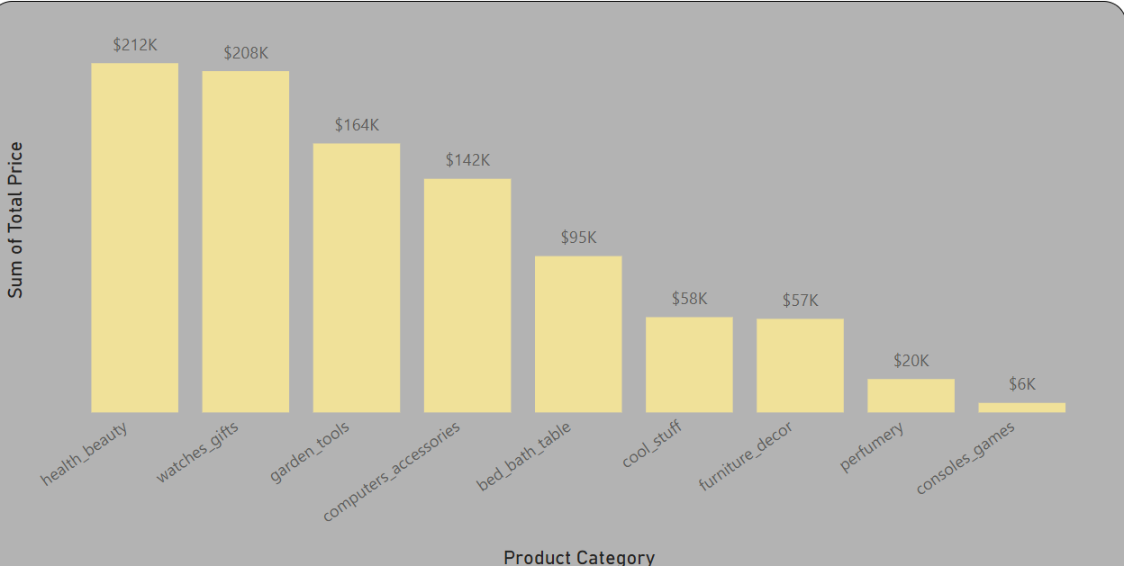
Value-Based Pricing
Sales Volume:
Highest Selling Products:
Best-sellers: Health & Beauty, Watches & Gifts.
Lowest sellers: Perfume, Consoles Games, Furniture Decor.

Slide 9
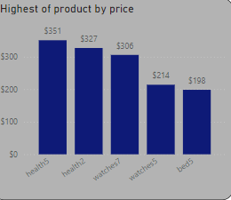
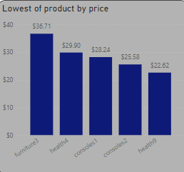
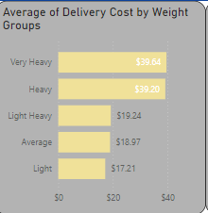
Value-Based Pricing
Sales Volume CONT:
Price Range:
Delivery Costs:
Highest: Heavy products with a cost of around $39.64.
Lowest: Small volume products at $15.54.
Best-selling products: Prices range from $198 (beds) to $351 (health & beauty).
Least-selling products: Prices range from $22.62 (health) to $36.71 (furniture).

Slide 10
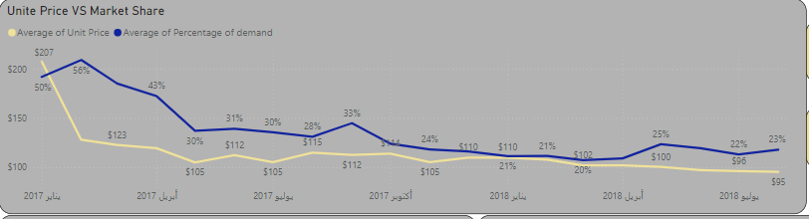
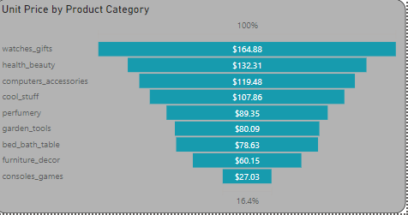
Value-Based Pricing
Sales Volume:
Price vs. Market Share Analysis
Unite price vs. market share: The graph shows a general inverse relationship between lagging price and market share. This suggests that lowering prices generally leads to an increase in market share. However, there are some exceptions that may require deeper
Unit Price by Product Category:
A horizontal bar chart representing the unit prices for different product categories. Watches & gifts has the highest unit price at $164.88, followed by health & beauty at $132.31.The lowest prices are in consoles & games ($27.03) and furniture decor ($60.15).

Slide 11
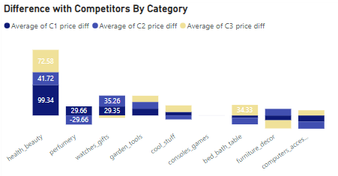
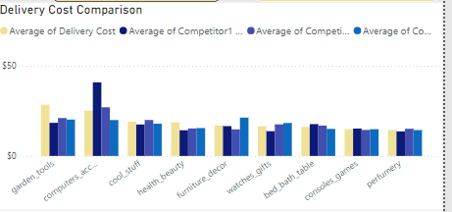
Competitive Pricing
Price Comparison to Competitors:
We have identified some categories (e.g., perfumes) where our prices are significantly different from competitors, with some categories showing a price difference as high as $29.66.
Delivery Cost Comparison:
Delivery costs show variations across categories. For example, differences in delivery costs are more prominent in garden tools and computer accessories categories.

Slide 12
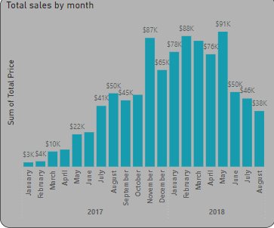
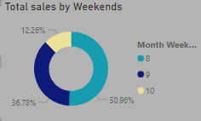
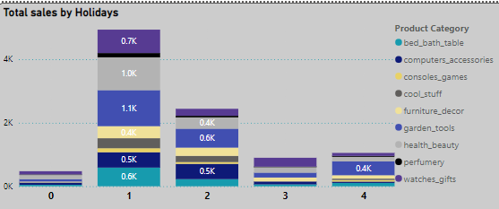
Dynamic Pricing
Months with Highest
and Lowest Sales:
Weekday vs.
Weekend Impact:
Holiday Sales:
Highest sales: in November with $87k in 2017 , peaking in May with $91k in 2018.
Lowest sales: Typically observed in January and February ($3k to $4k range) in 2017
Weekends account for around 12.26% of sales, while weekdays take the rest, showing a steady contribution to overall sales.
Significant sales spikes are observed during holidays, with health & beauty, watches gifts and gardens tools benefitting the most.

Slide 13
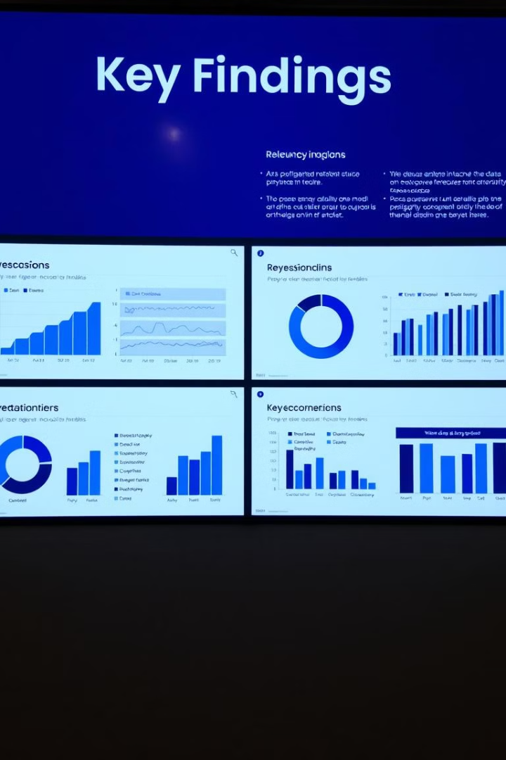
Key Findings & Recommendations
Price Sensitivity
Competitive Advantage
Products in certain categories are highly price-sensitive, requiring careful consideration when adjusting prices.
Optimizing prices can enhance competitive advantage by attracting new customers and increasing market share.
Customer Loyalty and Perceived Value:
Incorporate Demand Forecasting:
Develop demand forecasting models that account for seasonality and market shifts. Use these models to prepare for demand surges by adjusting prices and stock levels.
Pricing that aligns with the brand's perceived value contributes to long-term customer loyalty. Customers often expect prices to reflect product quality
Implement markdown optimization to ensure that slow-moving inventory is cleared without eroding profit margins.
note
By adopting a comprehensive, data-driven approach to price optimization, retailers can not only maximize profitability but also build strong customer relationships by offering fair, competitive, and personalized pricing.

Slide 14

Conclusion
By implementing a data-driven approach to price optimization, retailers can make informed decisions, enhance profitability, and gain a competitive edge in the market.

Slide 15

Q&A
Open for questions and discussion about the presented insights and recommendations for retail price optimization.

